Slide 1
CSE 4539 (CSE) / CSE 4581 (BScTE (2yr) 1st Sem)
: Web Programming
JavaScript
Md. Nazmul Haque
Lecturer, IUT
Department of Computer Science and Engineering
Islamic University of Technology
Notes:
Assalamualaikum, good day my respected teachers, audiences. Today I am going to present my thesis paper titled “Class Specific feature Selection for High Dimensional low sample size Data”. I am Nazmul haque and my supervisor is Dr. Mohammad Shoyaib.
Before going in detail about my Literature review, I would like to give an outline of my whole presentation.

Slide 2
Contents
Contents
Basic(s) of any programming language
Statement
Variable and way of declaring variables
Data type
Block
JavaScript Array

Slide 3

JavaScript
Basic(s) of JavaScript
Statement
Programming instructions, executed by computer

Slide 4
JavaScript
Basic(s) of JavaScript
Variable and way of declaring variables
Variables are containers for storing data (storing data values).
Four ways to declare a variable: var, let, const, mentioned nothing

Slide 5
JavaScript
Basic(s) of JavaScript
Variable and way of declaring variables
var: Declares a function-scoped or globally-scoped variable, optionally initializing it to a value
let: Declares a block-scoped local variable, optionally initializing it to a value
const: Same of let. However, the value of const variables can NOT be changed through reassignment and even can NOT be redeclared.

Slide 6
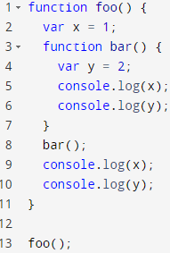
JavaScript
Basic(s) of JavaScript
Scope of a variable
Output:
1
2
1
Reference error

Slide 7
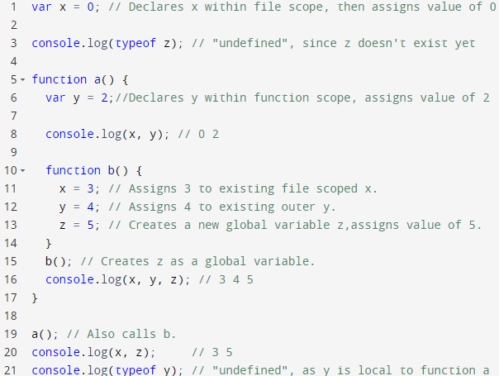
JavaScript
Basic(s) of JavaScript
Scope of a variable

Slide 8
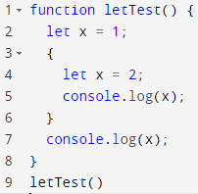
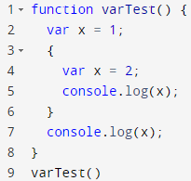
JavaScript
Basic(s) of JavaScript
Scope of a variable
Output:
2
1
Output:
2
2

Slide 9
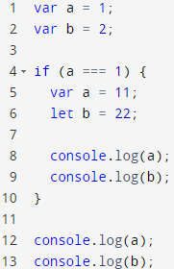
JavaScript
Basic(s) of JavaScript
Scope of a variable
Output:
11
22
11
2

Slide 10
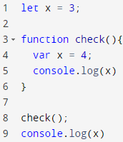
JavaScript
Basic(s) of JavaScript
Scope of a variable
Output:
4
3

Slide 11
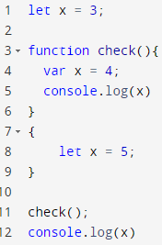
JavaScript
Basic(s) of JavaScript
Scope of a variable
Output:
4
3

Slide 12
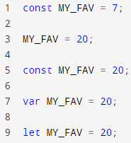
JavaScript
Basic(s) of JavaScript
Scope of a variable
Output:
Error! …

Slide 13
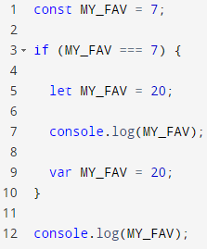
JavaScript
Basic(s) of JavaScript
Scope of a variable
Output:
20
7
Output:
Error

Slide 14
JavaScript
Basic(s) of JavaScript
Data Type
Primitive values
Boolean: True, False
Number: 12, 43, 12.43
String: “Web Programming”
etc
Objects
Course { code:"CSE 4581", name: "Web Programming", credit: 3 }

Slide 15
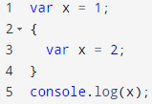
JavaScript
Basic(s) of JavaScript
Block
A set of statements grouped together.
Delimited by a pair of curly brackets {}.

Slide 16
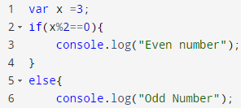
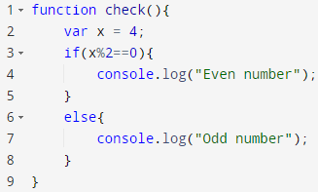

JavaScript
Basic(s) of JavaScript
Block (different ways)
Curly bracket
If else condition
loop (for, while)
function

Slide 17

JavaScript
Basic(s) of JavaScript
Array
Store a collection of multiple items under a single variable name
source: https://developer.mozilla.org/en-US/docs/Web/JavaScript/Reference/Global_Objects/Array

Slide 18
ANY QUESTION ?
THANK YOU !

Slide 19
References
References
[1] W3school.com

